Slide 1
ICTO-SLM : Install app from iTunes
2014年5月23日
Install app from iTunes
IBS Viet Nam
ver.1.0.0

Slide 2
改訂履歴
Ver. | 改訂内容 | 改訂者 | 改訂日 | 備考
1.0.0 | Step by step install | IBS VietNam | 2014/05/23

Slide 3
Introduction
This document is a guideline install app from iTunes (computer) to your IPhone

Slide 4
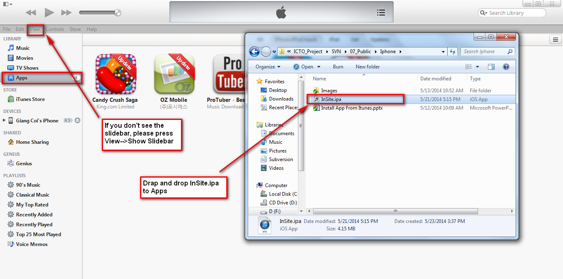
Install app with iTunes
1. Login your iTunes in computer.
2. Connect IPhone with iTunes and do as below

Slide 5
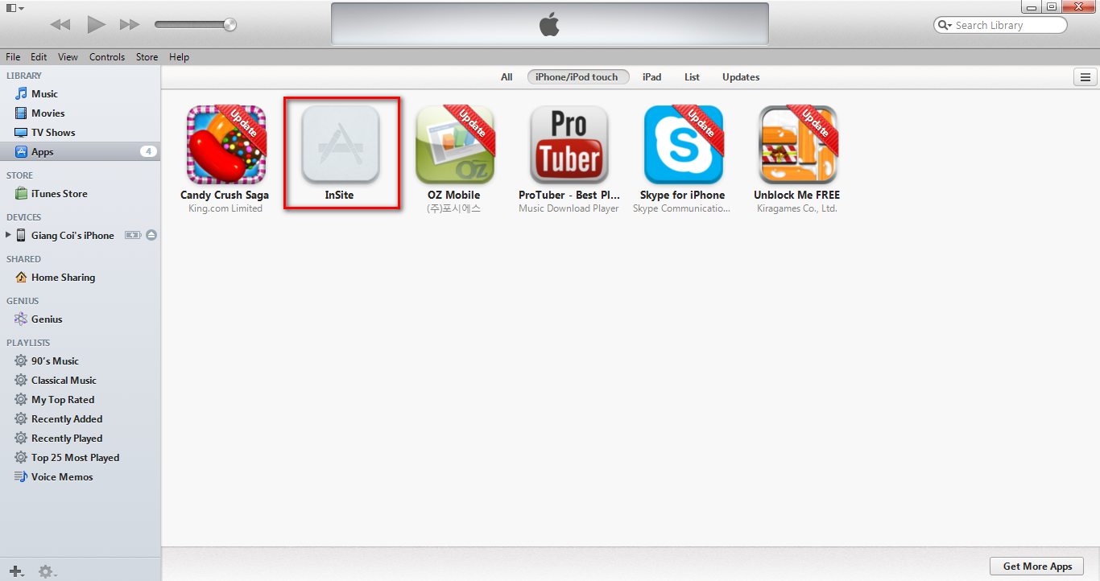
Install app with iTunes (cont.)
1. App “InSite” will show as below

Slide 6
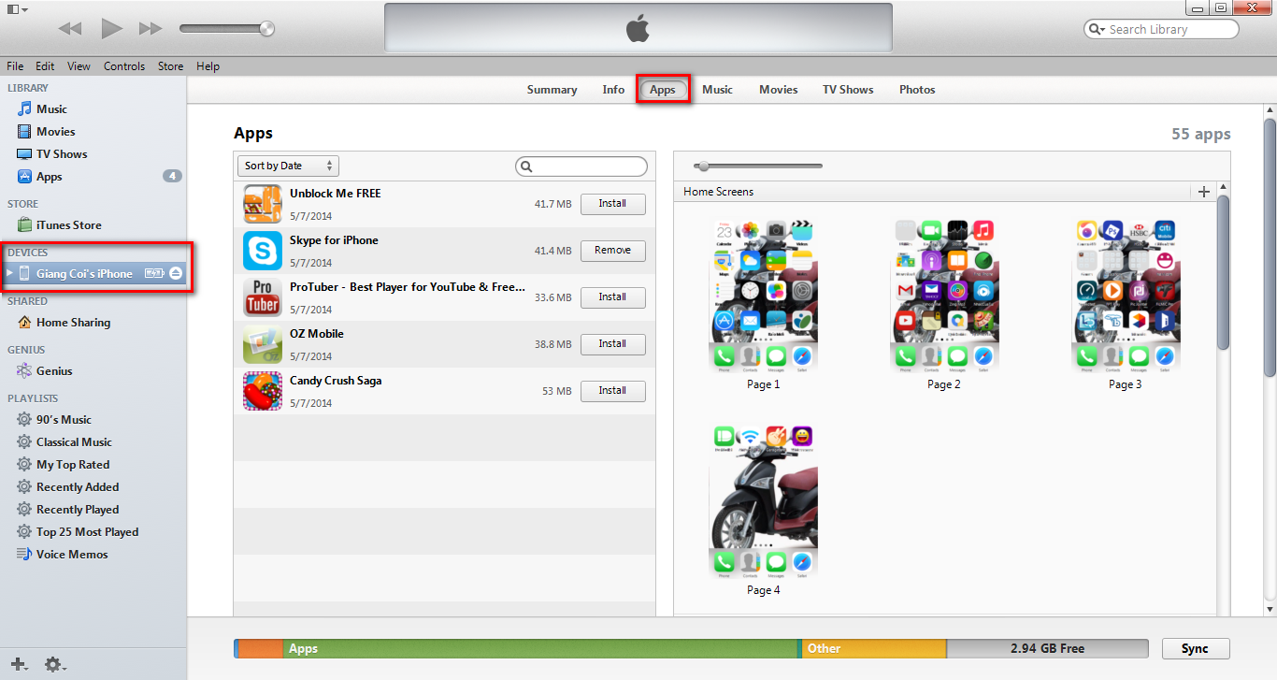
Install app with iTunes (cont.)
1. Select your device
2. Click “Apps” in a top center

Slide 7
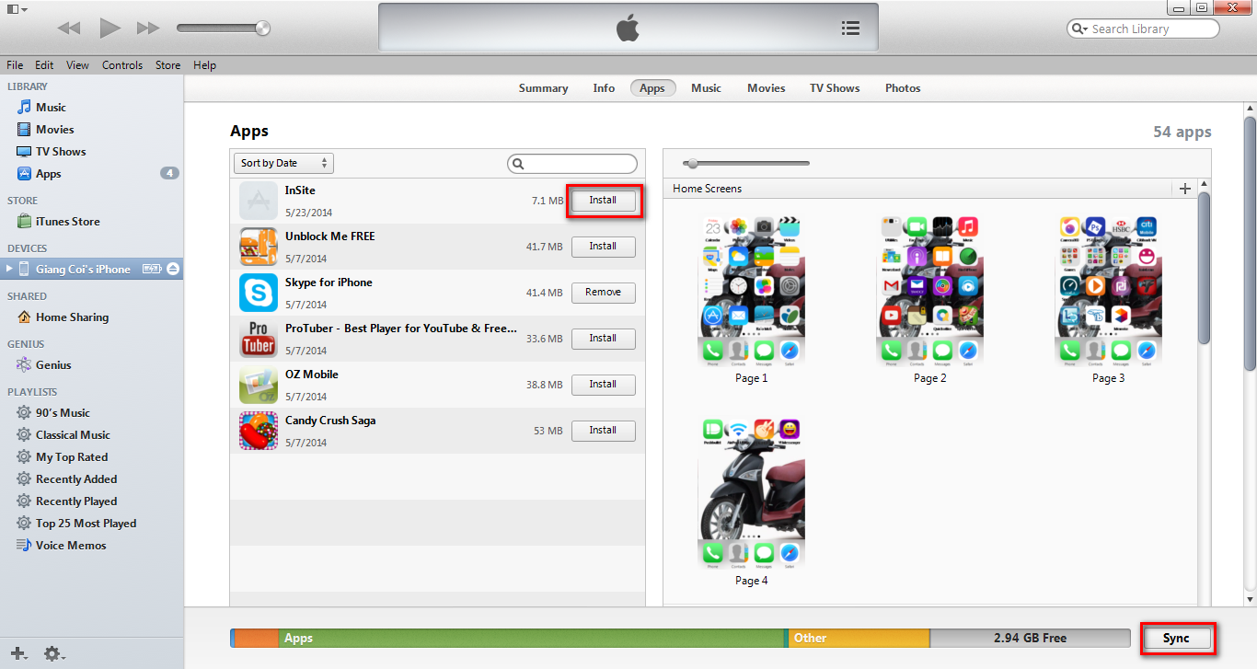
Install app with iTunes (cont.)
1. Select “InSite” and click button “Install”
2. “InSite” will change button “Will Install”
3. Then click “Sync” or “Apply” in the right bottom

Slide 8
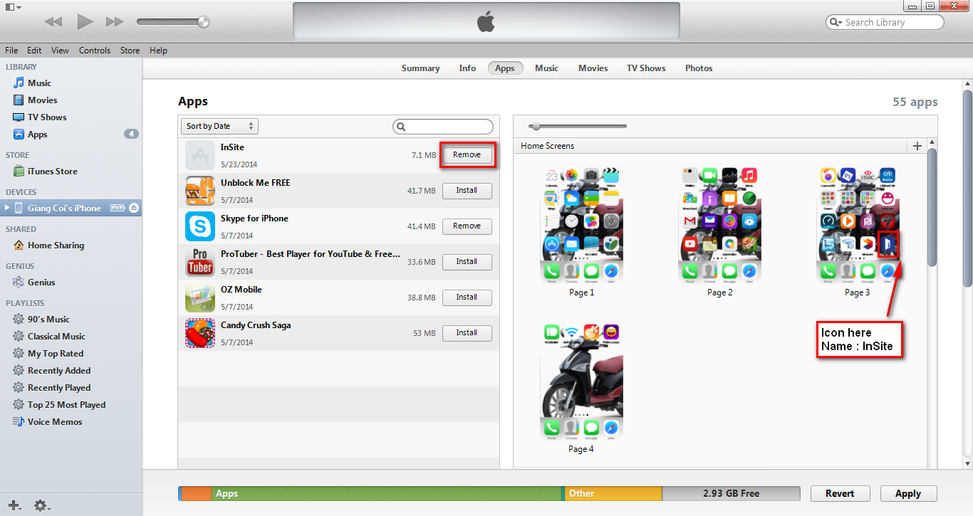
Install app with iTunes (cont.)
When “InSite” change button “Remove”. Application setup success in your device

